Slide 1
Week 3
Assignment：Load Balancing
Name：张颜兵
Id：12132428
Department：MAE
SuperVisor：Prof.吴雷
Research Topic：Engineering calculation

Slide 2





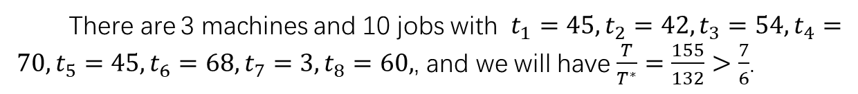






E1
你好There are 3 machines and 10 jobs with $t_{1}=45,t_{2}=42,t_{3}=54,t_{4}=70,t_{5}=45,t_{6}=68,t_{7}=3,t_{8}=60,$, and we will have $\frac{T}{T^{∗}}=\frac{155}{132}>\frac{7}{6}$.
$$Sorted Greedy$$
$$Optimal$$
$$t_{4}=70,t_{5}=45$$
$$t_{1}=45,t_{2}=42,t_{5}=45$$
M1
M1
$t_{6}=68,$ $t_{1}=45,t_{2}=42$
$t_{3}=54,$ $t_{4}=70,t_{7}=3$
M2
M2
$t_{8}=60,$ $t_{3}=54,t_{7}=3$
$t_{6}=68,$ $t_{8}=60$
M3
M3
$T=\max\left\{115,155,117\right\}=155$；
$T^{∗}=\max\left\{132,127,128\right\}=132$；

Slide 3
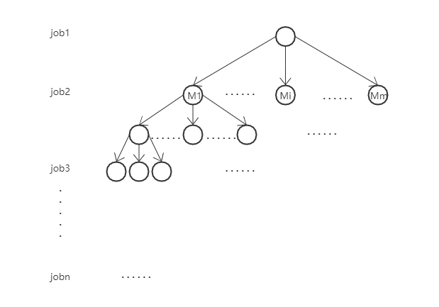
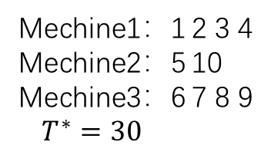
E2
The first kind of algorithm：characterize the problem as a complete m tree
Mechine1：1 2 3 4
Mechine2：5 10
Mechine3：6 7 8 9
$T^{∗}=30$
Number of operations：
num=59049 //before adding constraints
num=16741 //after adding constraints
完全m叉树

Slide 4
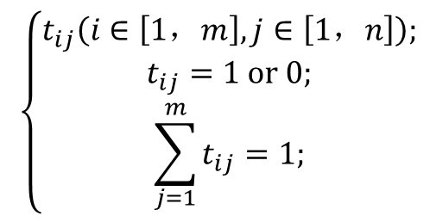
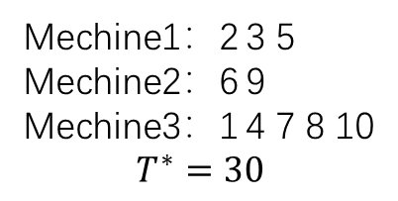
E2
The second kind of algorithm：use genetic algorithm to get the optimal makespan
Parameter settings：
const int MEA=10000;//Maximum evolutionary algebra
const int PN=100; //Population number
const double CP=0.6; //Crossover probability
const double MP=0.3; //Mutation probability
const int N=110; //Maximum chromosome length
const int M=50; //Maximum number of working machines
Load balancing data structure：
$$\left\{\begin{aligned}t_{ij}\left(i∈\left[1，m\right],j∈\left[1，n\right]\right); \\ t_{ij}=1 or 0; \\ \sum_{j=1}^{m}{t_{ij}=1;}\end{aligned}\right.$$
Mechine1：2 3 5
Mechine2：6 9
Mechine3：1 4 7 8 10
$$T^{∗}=30$$
Average number of iterations is 112.

Slide 5



E2
The second kind of algorithm：use genetic algorithm to get the optimal makespan
 | J1 | J2 | J3 | J4 | J5 | J6 | J7 | J8 | J9 | J10
M1 | 3 | 6 | 9 | 12 | 15 | 18 | 21 | 24 | 27 | 30
M2 | 2 | 4 | 6 | 8 | 10 | 12 | 14 | 16 | 18 | 20
M3 | 1 | 2 | 3 | 4 | 5 | 6 | 7 | 8 | 9 | 10
 | J1 | J2 | J3 | J4 | J5 | J6 | J7 | J8 | J9 | J10
M1 | 3 | 2 | 6 | 12 | 15 | 18 | 14 | 16 | 27 | 10
M2 | 2 | 6 | 3 | 8 | 10 | 12 | 7 | 24 | 18 | 30
M3 | 1 | 4 | 9 | 4 | 5 | 6 | 21 | 8 | 9 | 20
Iterate the 44th generation to obtain the optimal solution
Mechine1：2 3 5
Mechine2：6 9
Mechine3：1 4 7 8 10
Iterate the 106th generation to obtain the optimal solution
Mechine1：2 4 10
Mechine2：3 5 7
Mechine3：1 6 8 9
$$T^{∗}=30$$
$$T^{∗}=24$$
 | J1 | J2 | J3 | J4 | J5 | J6 | J7 | J8 | J9 | J10
M1 | 3 | 2 | 6 | 12 | 15 | 18 | 14 | 16 | 27 | 10
M2 | 3 | 2 | 6 | 12 | 15 | 18 | 14 | 16 | 27 | 10
M3 | 3 | 2 | 6 | 12 | 15 | 18 | 14 | 16 | 27 | 10
Iterate the 163th generation to obtain the optimal solution
Mechine1：5 8 10
Mechine2：1 3 6 7
Mechine3：2 4 9
$$T^{∗}=41$$
The above three examples have all been verified by the first algorithm and get the same results.

